Slide 1
Recyclemania
Team Name: Trash Cans
Members: Josh Cobble, Jesus de Leon, Jeremy Hurley, Justin Klippstein

Slide 2
Scenario and Problem Statement
On average, Americans throw away about 76% of recyclable items. Because of this, most recyclable items are never recycled since they are lost in the trash with other trash items.
Our goal is to educate people about what types of items are recyclable so that these items can be recycled rather than thrown away. Recycling is good for the environment because it reuses old items instead of using more resources and potentially non-environmentally friendly processes to make new ones.

Slide 3
Game Overview
Our recycling game is simple. The user is prompted with a question and has to choose 1 of the multiple choice answers given to them. After answering a question, the user will then move on to the next question (there are 20 questions in total, which are given in a random order).
Whether the user gets a question incorrect or correct, a random fun fact will also appear after the question is answered.

Slide 4
Building the Game
There are several parts to this game:
Arraylists to store recyclables and non recyclables
Questions with choices appearing in a random order
JavaFX implementation

Slide 5
Arraylists for Recyclables and Non Recyclables
We came up with several types of items (plastic, paper, metal, etc) and came up with arraylists for each. Under each arraylist, we came up with items for each type (ex: newspaper for paper). We then created an arraylist for recyclables and non recyclables. Then, we added the recyclable item arraylists to the arraylist for recyclables. We also added the non recyclable item arraylists to the arraylist for non recyclables.

Slide 6
Simple and Complex Questions
We created two types of question objects: simple and complex questions. For simple questions, we added text to each question object. For the subject of these questions, we pulled an item from the arraylists. For the complex questions, we did the same thing, but pulled arraylist items for the choices instead of the question text.

Slide 7
Fun Facts and Question Randomization
We added new arraylists, not to be confused with the prior arraylists. These stored fun facts about each item. These were then all stored into one arraylist. We then added a new arraylist for randomizing question order. To do this, we added used Collections.shuffle and a new fact object we linked to the arraylist that stores all the facts.

Slide 8
JavaFX Implementation
We implemented JavaFX into the previously mentioned parts of our code, such as handling user mouse movements, creating the atmosphere of the game, the color palette, question buttons for multiple choice answers, and more.

Slide 9
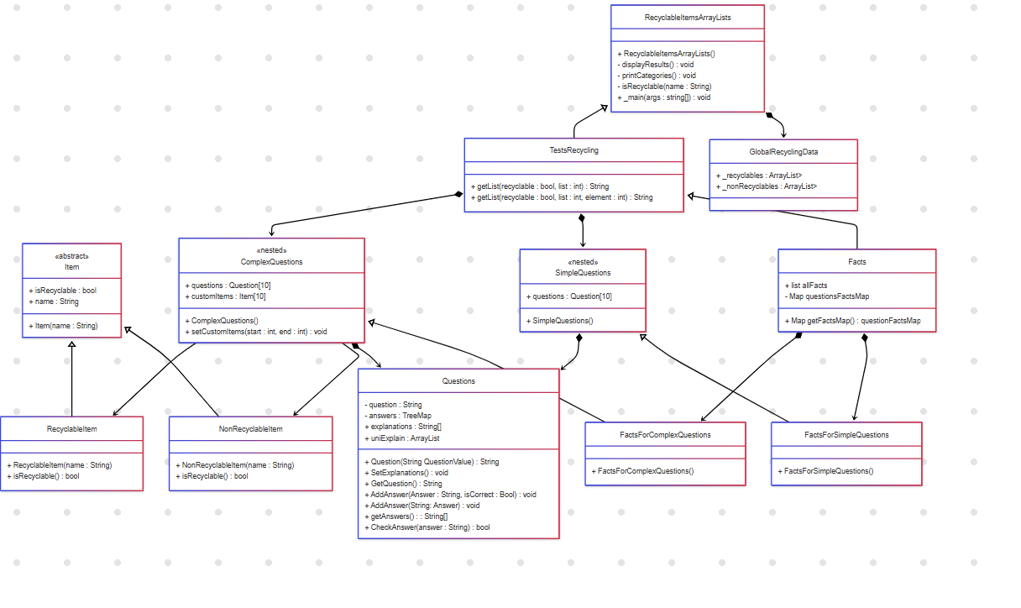
Summary of UML

Slide 10
What We Have Learned
After creating our game, we have learned a lot about recycling. We have learned which materials are and are not recyclable, as well as why. Furthermore, we have learned to communicate better with each other and work better as a team.

Slide 11
GitHub Repository
Click here to visit the Recyclemania GitHub repository

